Slide 1

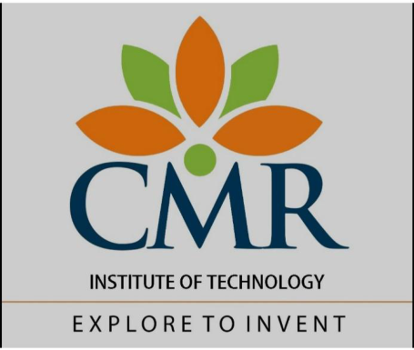
A Task on
Create a Use Class diagram for an ATM Application.
Submitted by :
Computer Science and Engineering(AI&ML) Department
R SAI CHANDRA
24R01A66H7
Submitted to :
Ms.J. Jyothi Bai
(Assistant professor, CSE(AI&ML) Department)
CMR INSTITUTE OF TECHNOLOGY
(UGC AUTONOMOUS)
(Approved by AICTE, Affiliated to JNTUH, Kukatpally, Hyderabad) Kandlakoya,
Medchal Road, Hyderabad 2025 -2026

Slide 2
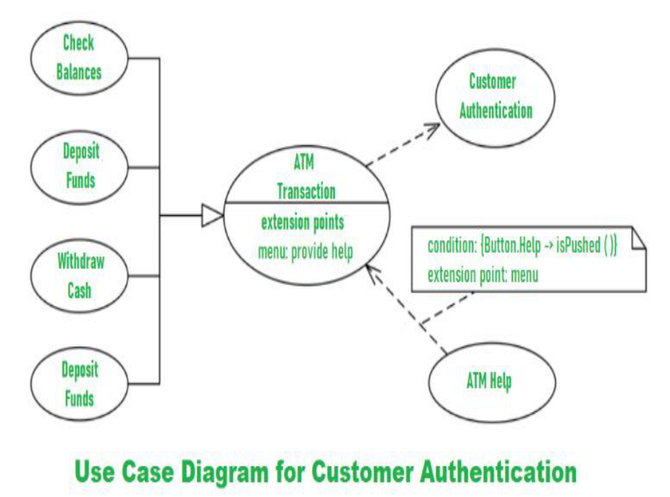
Create a Use Case diagram for an ATM Application.
Automated Teller Machine (ATM) also known as ABM (Automated Banking
Machine) is a banking system. This banking system allows customers or users to
have access to financial transactions. These transactions can be done in public
space without any need for a clerk, cashier, or bank teller. Working and
description of the ATM can be explained with the help of the Use Case Diagram.
We will understand about designing the use case diagram for the ATM system.
Some scenarios of the system are as follows.
•
Step-1: The user is authenticated when enters the plastic ATM card in a
Bank ATM. Then enters the user name and PIN (Personal Identification
Number). For every ATM transaction, a Customer Authentication use case
is required and essential. So, it is shown as include relationship. Example
of use case diagram for Customer Authentication is shown below:

Slide 3
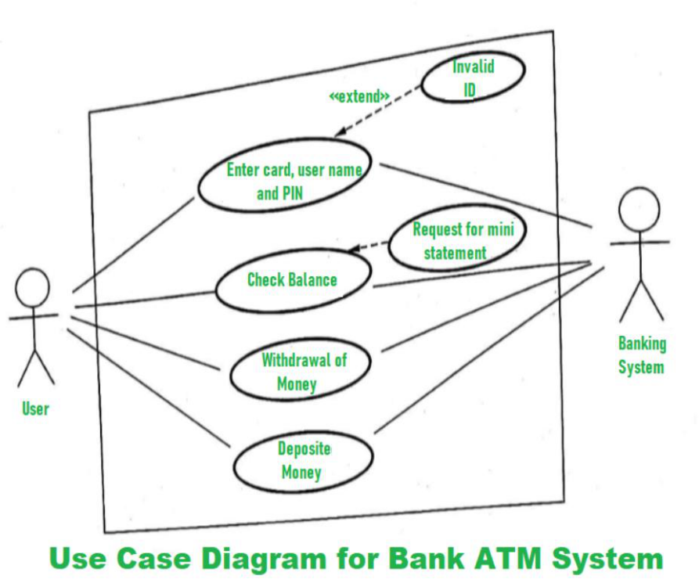
•
Step-2: User checks the bank balance as well as also demands the mini
statement about the bank balance if they want. Then the user withdraws
the money as per their need. If they want to deposit some money, they
can do it. After complete action, the user closes the session. Example of
the use case diagram for Bank ATM system is shown below:
•
Step-3: If there is any error or repair needed in Bank ATM, it is done by an
ATM technician. ATM technician is responsible for the maintenance of the
Bank ATM, upgrades for hardware, firmware or software, and on-site

Slide 4
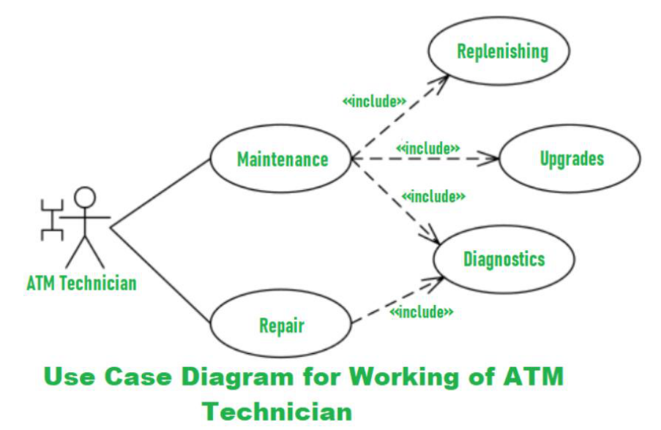
diagnosis. Example of use case diagram for working of ATM technician is
shown below:

